Slide 1
Flag Register
Microprocessors and microcomputer-based system design
Mohamad Rafiquzzaman
>Chapter 3 section 3.1, 3.2, 3.3 Assembly language programming Ytha Yu
Organization of. the 8086 Microprocessors Chapter 3 section 3.2
FLAGS Register Chapter 5 section 5.1, 5.2, 5.3
Md. Shafqat Talukder Rakin
Lecturer, Department of CSE,
United International University
Email id : shafqat@cse.uiu.ac.bd
Courtesy: Nasif M. Sir

Slide 2
Flag Register
Assembly language programming Ytha Yu
section 5.1 The FLAG register
Section 5.2 Overflow
Section 5.3 How Instructions affect the Flags
Overflow
Carry flag
Parity flag
Direction
Interrupt enable
Auxiliary flag
Zero
Trap
Sign
6 are status flags
3 are control flag

Slide 3
Flag Register
Status flag: The status flags reflect the result of an instruction executed by the processor.
Control flag: The control flags enable or disable certain operations of the processor.

Slide 4
Flag Register Description (1)
SF (sign) set to 1 when result is negative. When result is
positive it is set to 0. This flag take the value of the most significant bit.
ZF (zero) Indicates when the result of arithmetic or a comparison is zero. set to 1 when result is zero. For non zero result this flag is set to 0.
CF (Carry) Set 1, if carry out of MSB.
AF (auxiliary carry) Set 1, if carry out of bit 3 into bit 4.
PF (parity) Set 1, if the number of 1 bits is even in the low-order byte of the result.

Slide 5
Flag Register Description (2)
OF (overflow) set 1, if there is an arithmetic overflow for signed integer.
DF (direction) Indicates left or right for moving or comparing string data.
IF (interrupt) Indicates whether external interrupts are being processed or ignored.
TF (trap) Permits operation of the processor in single step mode. Set (1) for step by step debugging.

Slide 6
Flag Register
The next figure shows the bit definitions for the 16-bit flag register.
Six of the flags are status indicators reflecting properties of the result of the last arithmetic or logical instruction
8086 flag word. DF, IF, and TF can be set or reset to control the operation of the processor

Slide 7

Flag Register
For more example read section 5.3
Example
AL=80H CF=0
PF=0 AF=l ZF=0
SF=1 OF=1
7FH + 1 = 80H
there is no carry out of bit 7
odd number of ones
There is carry out of bit 3 into bit 4
Result non-zero.
Msb value is one (negative)
The range of the signed integer is [0 to +127 & -1 to -128] (for 8-bit). Here the result is negative number but both inputs are positive number. Therefore, there is overflow.

Slide 8
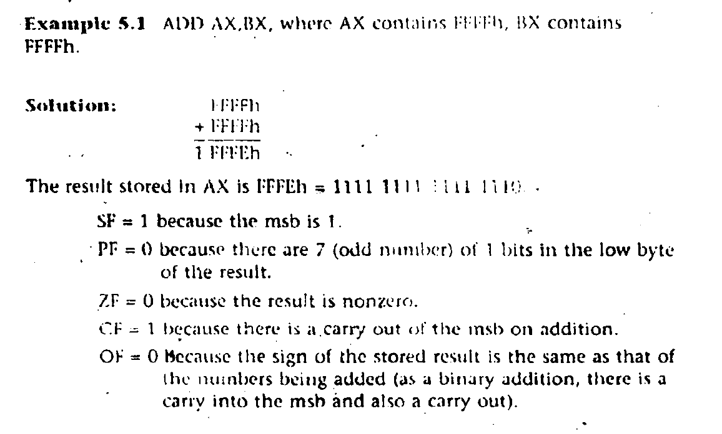

Slide 9
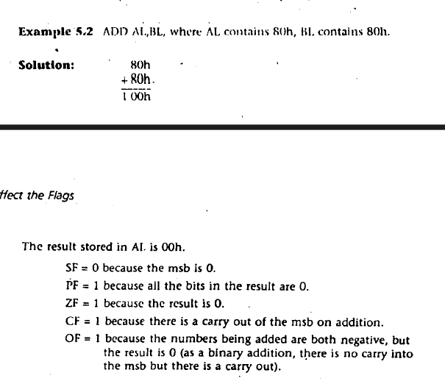

Slide 10
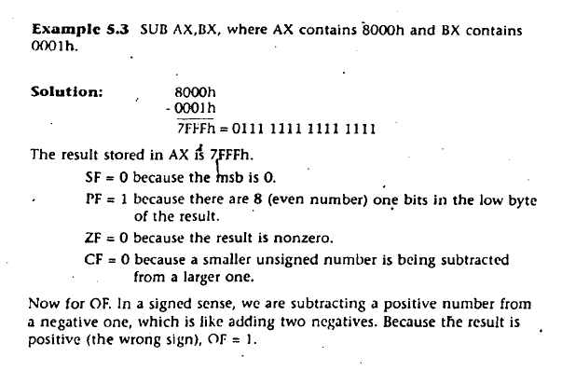

Slide 11
Thank You

